Slide 1
Chapter 7
Binary Search Trees
Objectives
Upon completion you will be able to:
Create and implement binary search trees
Understand the operation of the binary search tree ADT
Write application programs using the binary search tree ADT
Design and implement a list using a BST
Design and implement threaded trees

Slide 2
7-1 Basic Concepts
Binary search trees provide an excellent structure for searching a list and at the same time for inserting and deleting data into the list.

Slide 3
Basic Concepts
A binary search tree (BST) is a binary tree with the following properties:
  All items in the left subtree are less than the root.
  All items in the right subtree are greater than or equal to the root.
  Each subtree is itself a binary search tree.

Slide 4
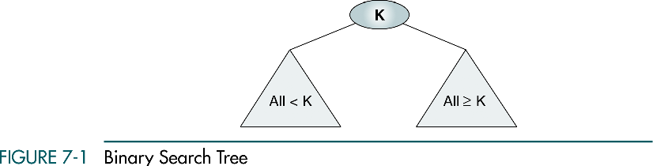

Slide 5
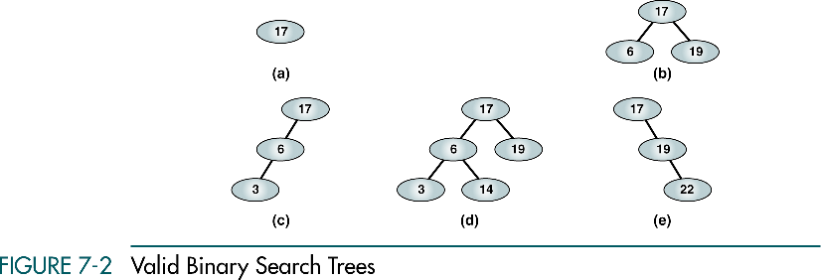

Slide 6
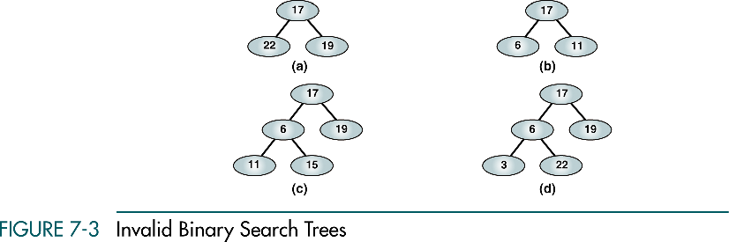

Slide 7
7-2 BST Operations
We discuss four basic BST operations: traversal, search, insert, and delete; and develop algorithms for searches, insertion, and deletion.
Traversals
Searches
Insertion
Deletion

Slide 8
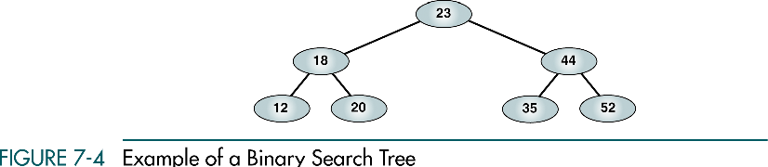

Slide 9
Traversals
Preorder traversal
  23 18 12 20 44 35 52
Postorder traversal
  12 20 18 35 52 44 23
Inorder traversal
  12 18 20 23 35 44 52
The inorder traversal of a binary search tree produces a sequenced list

Slide 10
Traversals
What happens if you traverse the tree using a right-node-left sequence?
  52 44 35 23 20 18 12

Slide 11
Searches
Three search algorithms:
  Find the smallest node
  Find the largest node
  Find a requested node(BST search)

Slide 12
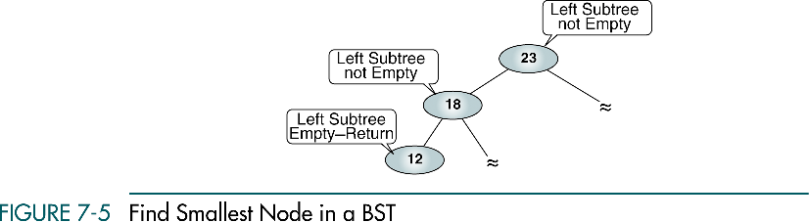
Find the smallest node

Slide 13
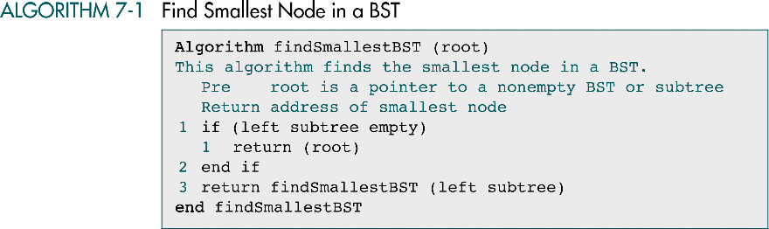

Slide 15
Find the largest node
right subtree not empty
right subtree not empty
right subtree empty return

Slide 16
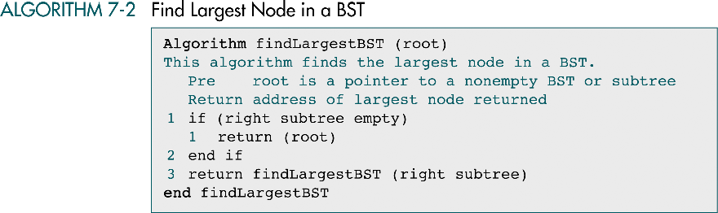

Slide 17
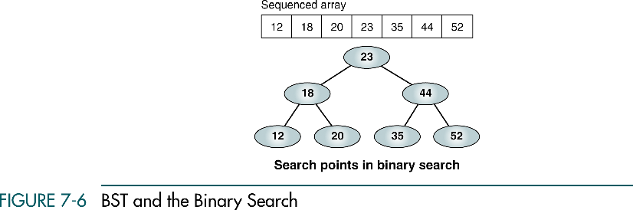

Slide 18
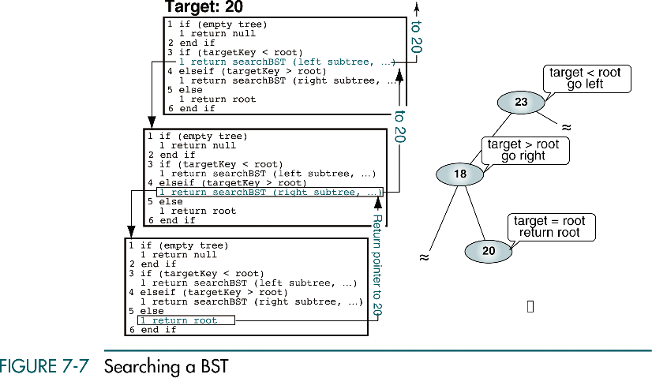

Slide 19
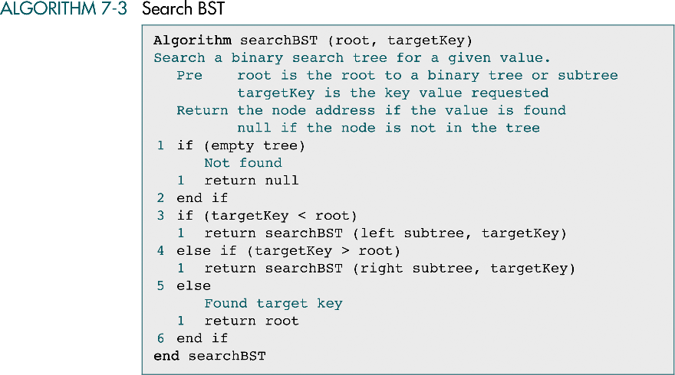

Slide 20
Insertion
All BST insertions take place at a leaf or a leaf like node.
A node that has only one null subtree.

Slide 21
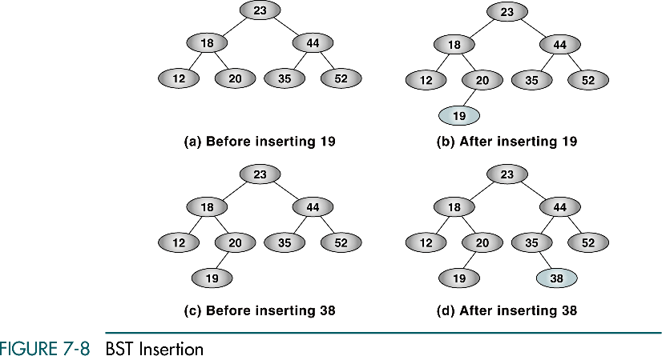

Slide 22
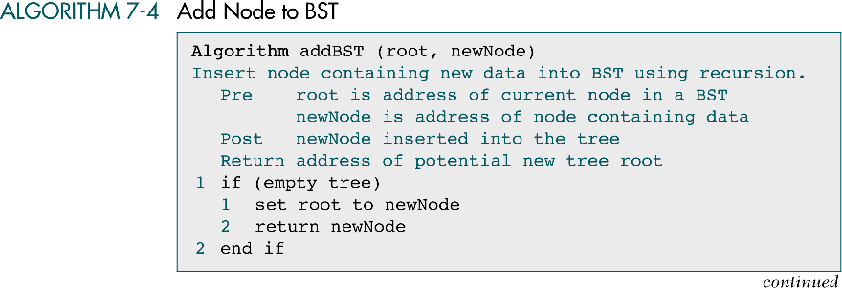
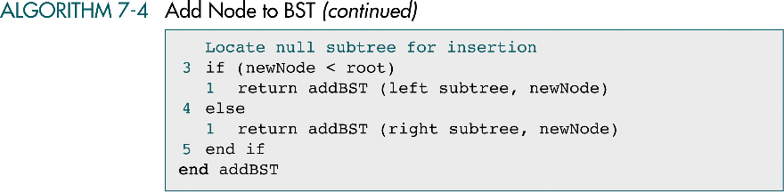

Slide 23
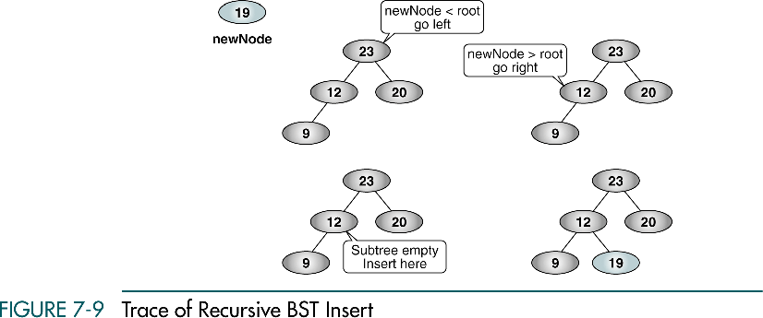

Slide 24
Deletion
To delete a node from a binary search tree, we must first locate it.
There are four possible cases when we delete a node. The node
  has no children.
  has only a right subtree.
  has only a left subtree.
  has two subtrees.

Slide 25
Four cases when we delete a node
The node has no children.
  Just delete the node
The node has only a right subtree.
  delete the node
  attach the right subtree to the deleted node’s parent.

Slide 26
Four cases when we delete a node
The node has only a left subtree.
  delete the node
  attach the left subtree to the deleted node’s parent.

Slide 27
Four cases when we delete a node
The node has two subtrees.
  Find the largest node in the deleted node’s left subtree and move its data to replace the deleted node’s data or
  Find the smallest node in the deleted node’s right subtree and move its data to replace the deleted node’s data.

Slide 28
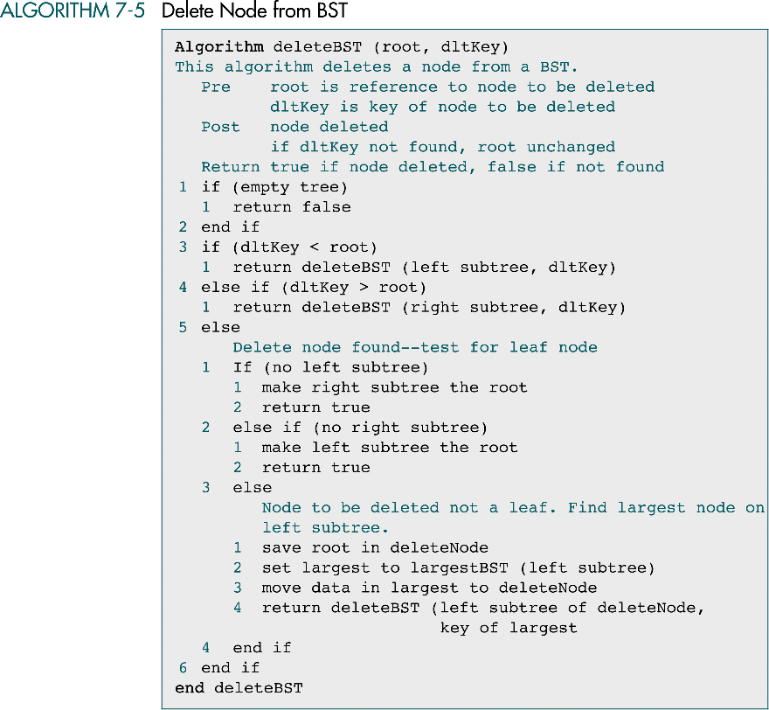

Slide 29
(continued)

Slide 30
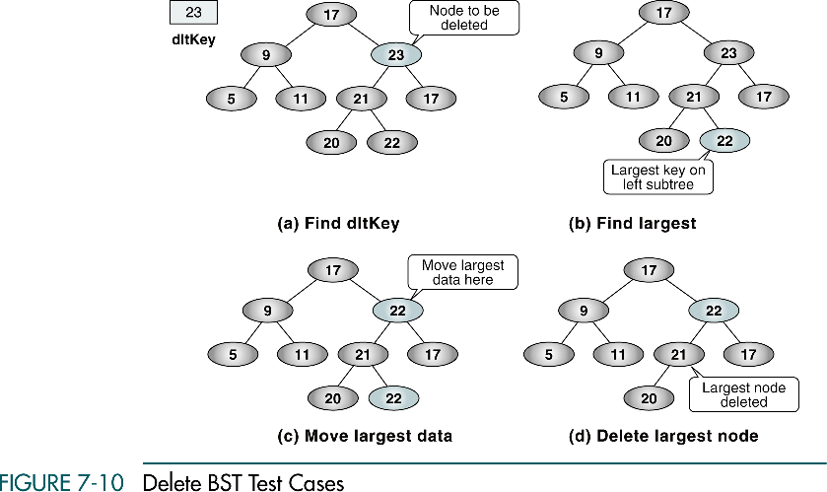

Slide 31
7-3 Binary Search Tree ADT
We begin this section with a discussion of the BST data structure and write the header file for the ADT. We then develop 14 programs that we include in the ADT.
Data Structure
Algorithms

Slide 32
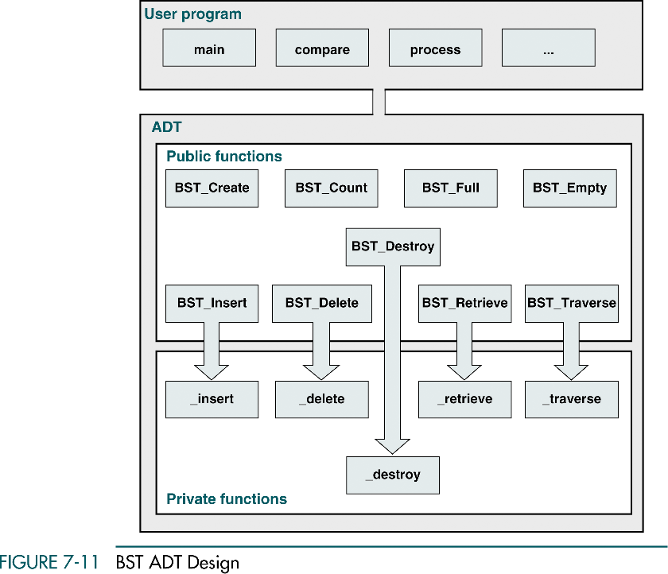

Slide 33
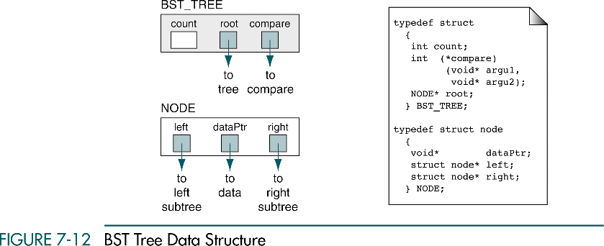

Slide 34
BST tree operations
BST_Create
BST_Insert
BST_Delete
BST_Retrieve
BST_Traverse
BST_Count
BST_Full
BST_Empty
BST_Destroy

Slide 35
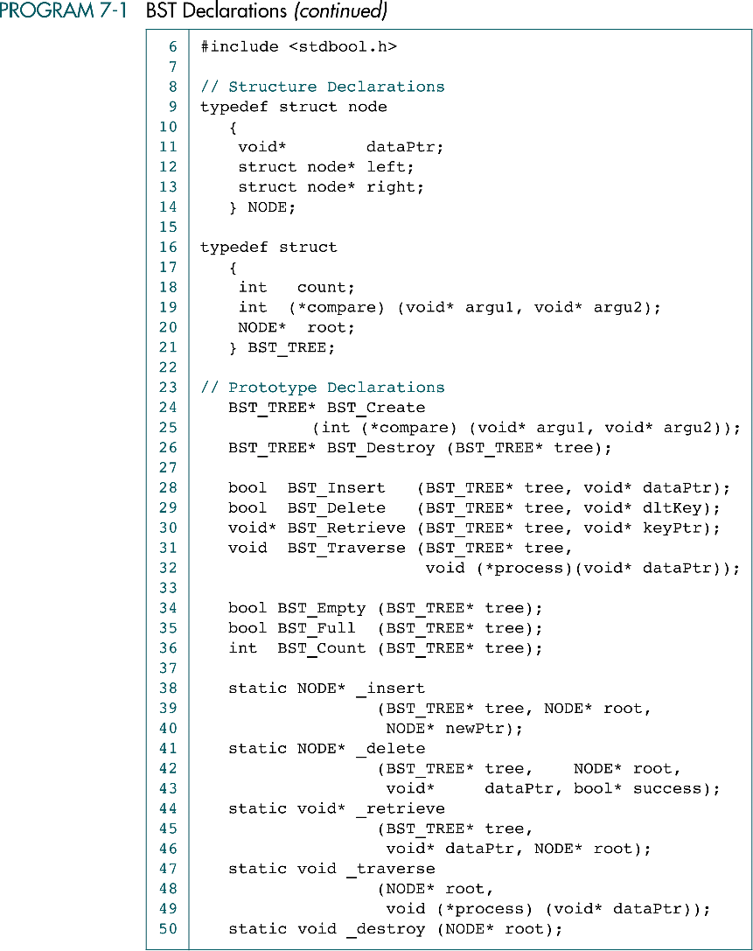
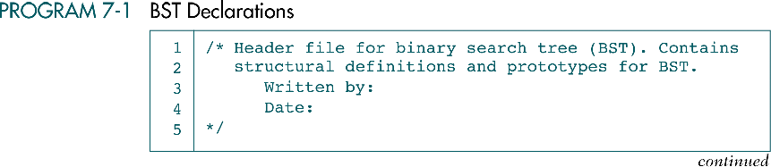

Slide 38
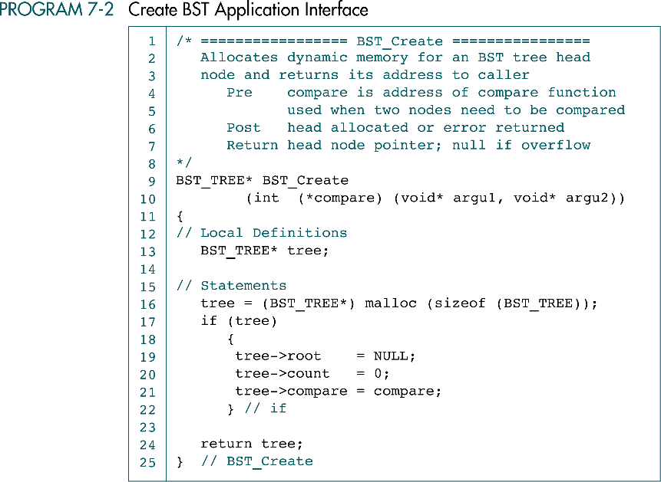

Slide 39
BST tree ADT operations
BST_TREE BST_Create(int (*compare) (void* argu1 void* argu2))
  Allocates dynamic memory for an BST tree head node and returns its address to caller.
  compare is address of compare function used when two node need to be compared.
  Return a head node pointer; null if overflow
BST_TREE* BST_Destroy( BST_TREE* tree )
  Delete all data in tree and recycles memory.
  tree is pointer to BST tree structure
  Returns null head pointer.

Slide 40
BST tree ADT operations
bool BST_Insert( BST_TREE* tree, void* dataPtr )
  Inserts new data into the tree.
  tree is pointer to BST tree structure
  Return success (true) or overflow (false)
bool BST_Delete( BST_TREE* tree, void* dataPtr )
  Deletes a node from the tree and rebalances it if necessary.
  tree is pointer to BST tree structure
  Return success (true) or Not found (false)

Slide 41
BST tree ADT operations
void* BST_Retrieve( BST_TREE* tree, void* dataPtr )
  Retrieve node searches tree for the node containing the requested key and returns pointer to its data.
  tree is pointer to BST tree structure
  Return the address of matching node. If not found, return NULL.
void BST_Traverse( BST_TREE* tree, void (*process) (void* dataPtr) )
  Process tree using inorder traversal
  tree is pointer to BST tree structure
  process is address of process function used to visit a node during.

Slide 42
BST tree ADT operations
void* BST_Empty( BST_TREE* tree )
  Returns true if tree is empty; false if any data.
  tree is pointer to BST tree structure
  Returns true if there empty, false if any data.
bool BST_Full( BST_TREE* tree )
  If there is no room for another node, returns true.
  tree is pointer to BST tree structure
  Returns true if no room for another insert; false if room.
int BST_Count( BST_TREE* tree )
  Returns number of nodes in tree.
  tree is pointer to BST tree structure
  Returns tree count.

Slide 43
7-4 BST Applications
This section develops two applications that use the BST ADT. We begin the discussion of BST Applications with a simple application that manipulates integers. The second application, student list, requires a structure to hold the student's data.
Integer Application
Student List Application (Self-reading)

Slide 44
Integer Application
The BST tree integer application reads integers from the keyboard and inserts them into the BST.

Slide 45
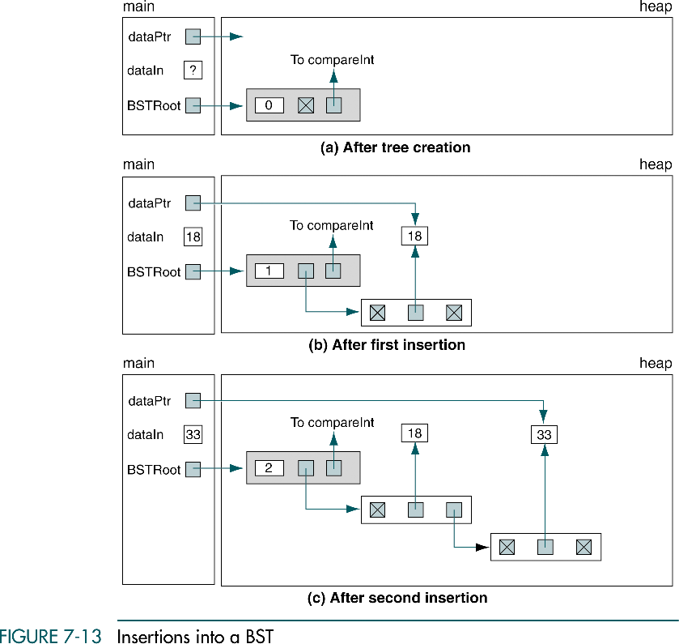
18, 33

Slide 46
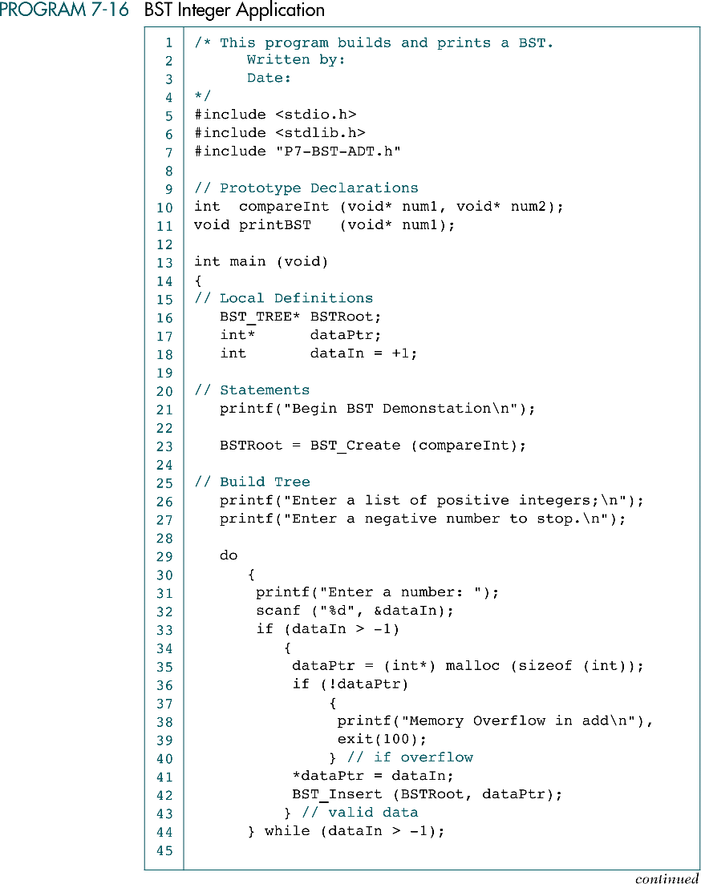
compare
process

Slide 47
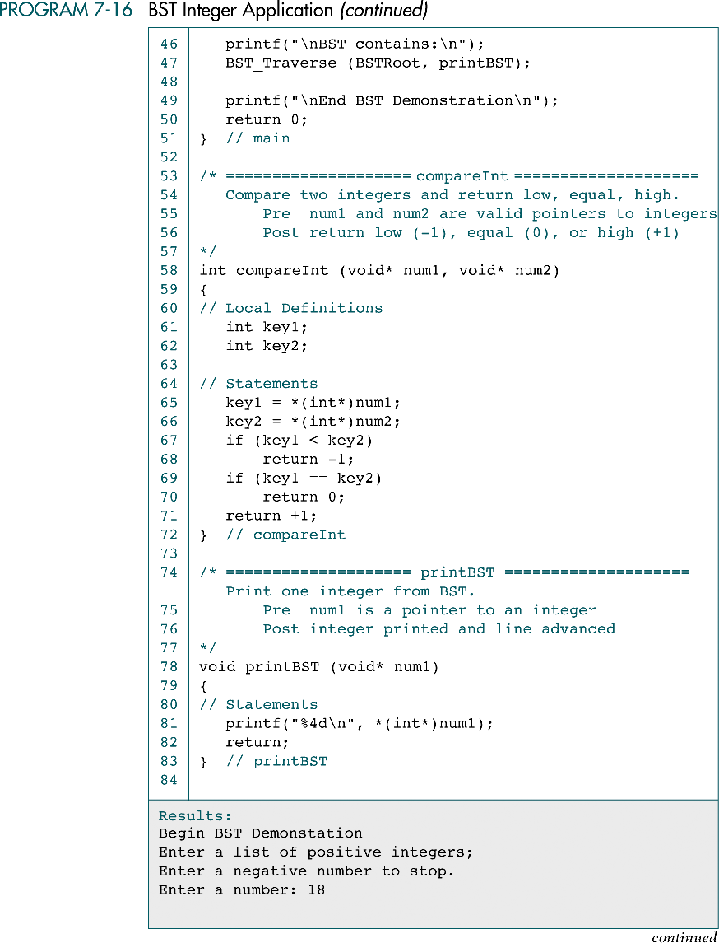

Slide 50
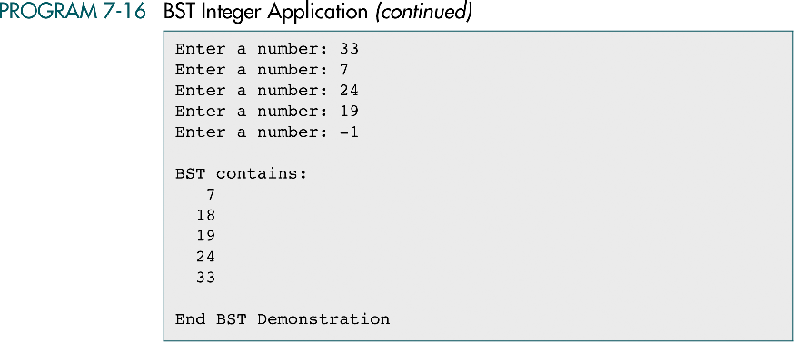

Slide 51
7-5 Threaded Trees
This section develops two applications that use the BST ADT. We begin the discussion of BST Applications with a simple application that manipulates integers. The second application, student list, requires a structure to hold the student's data.

Slide 52
